Slide 1
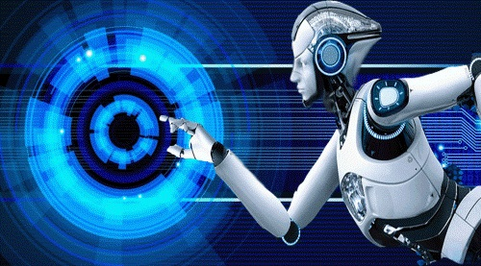
PROFESSIONAL ETHICS OF AI

Slide 2
WHAT IS ARTIFICIAL INTELLIGENCE?
One of the booming technologies of computer science is Artificial Intelligence which is ready to create a new revolution in the world by making intelligent machines.
The Artificial Intelligence is now all around us. It is currently working with a variety of subfields, ranging from general to specific, such as self-driving cars, playing chess, proving theorems, playing music, Painting, etc.
AI is one of the fascinating and universal fields of Computer science which has a great scope in future. AI holds a tendency to cause a machine to work as a human.

Slide 3
DEFINITION OF AI
Artificial Intelligence is composed of two words Artificial and Intelligence, where Artificial defines "man-made," and intelligence defines "thinking power", hence AI means "a man-made thinking power."
So, we can define AI as:
"It is a branch of computer science by which we can create intelligent machines which can behave like a human, think like humans, and able to make decisions."

Slide 4
Why Artificial Intelligence?
With the help of AI, you can create such software or devices which can solve real-world problems very easily and with accuracy such as health issues, marketing, traffic issues, etc.
With the help of AI, you can create your personal virtual Assistant, such as Cortana, Google Assistant, Siri, etc.
With the help of AI, you can build such Robots which can work in an environment where survival of humans can be at risk.
AI opens a path for other new technologies, new devices, and new Opportunities.

Slide 5
Goals of Artificial Intelligence
Replicate human intelligence
Solve Knowledge-intensive tasks
An intelligent connection of perception and action
Building a machine which can perform tasks that requires human intelligence such as:
Proving a theorem
Playing chess
Plan some surgical operation
Driving a car in traffic
Creating some system which can exhibit intelligent behavior, learn new things by itself, demonstrate, explain, and can advise to its user.

Slide 6
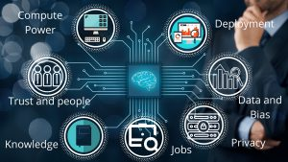
WHAT IS HARD FOR AI?
Computing Power
Trust Deficit
Limited Knowledge
Human-level
Data Privacy and Security

Slide 7
1. Computing Power
Machine Learning and Deep Learning are the stepping stones of this Artificial Intelligence, and they demand an ever-increasing number of cores and GPUs to work efficiently.
There are various domains where we have ideas and knowledge to implement deep learning frameworks such as asteroid tracking, healthcare deployment, tracing of cosmic bodies, and much more.
They require a supercomputer’s computing power, and yes, supercomputers aren’t cheap.

Slide 8
2. Trust Deficit
One of the most important factors that are a cause of worry for the AI is the unknown nature of how deep learning models predict the output.
How a specific set of inputs can devise a solution for different kinds of problems is difficult to understand for a layman.
Many people in the world don’t even know the use or existence of Artificial Intelligence, and how it is integrated into everyday items they interact with such as smartphones, Smart TVs, Banking, and even cars (at some level of automation).

Slide 9
3. Limited Knowledge
Although there are many places in the market where we can use Artificial Intelligence as a better alternative to the traditional systems.
The real problem is the knowledge of Artificial Intelligence. Apart from technology enthusiasts, college students, and researchers, there are only a limited number of people who are aware of the potential of AI.
For example, there are many SMEs (Small and Medium Enterprises) which can have their work scheduled or learn innovative ways to increase their production, manage resources, sell and manage products online, learn and understand consumer behavior and react to the market effectively and efficiently.
They are also not aware of service providers such as Google Cloud, Amazon Web Services, and others in the tech industry.

Slide 10
4. Human-level
This is one of the most important challenges in AI, one that has kept researchers on edge for AI services in companies and start-ups.
These companies might be boasting of above 90% accuracy, but humans can do better in all of these scenarios.
For example, let our model predict whether the image is of a dog or a cat. The human can predict the correct output nearly every time, mopping up a stunning accuracy of above 99%.

Slide 11
4. Human-level (CONT..)
For a deep learning model to perform a similar performance would require unprecedented finetuning, hyperparameter optimization, large dataset, and a well-defined and accurate algorithm, along with robust computing power, uninterrupted training on train data and testing on test data.
One way you can avoid doing all the hard work is just by using a service provider, for they can train specific deep learning models using pre-trained models.
They are trained on millions of images and are fine-tuned for maximum accuracy, but the real problem is that they continue to show errors and would really struggle to reach human-level performance.

Slide 12
5. Data Privacy and Security
The main factor on which all the deep and machine learning models are based on is the availability of data and resources to train them.
Yes, we have data, but as this data is generated from millions of users around the globe, there are chances this data can be used for bad purposes.

Slide 13
Science and Fiction of AI
In 1968, the Stanley Kubrick classic “2001” featured the famous example of HAL, a spacecraft’s intelligent control system which turns against its human passengers.
The Terminator movies (since 1984) are based on the idea that a neural network built for military defense purposes gains self-awareness and, in order to protect itself from deactivation by its human creators, turns against them.
The Steven Spielberg’s movie “A.I.” (2001), based on a short story by Brian Aldiss, explores the nature of an intelligent robotic boy (Aldiss 2001).
In the movie “I, Robot” (2004), based on motives from a book by Isaac Asimov, intelligent robots originally meant to protect humans are turning into a menace.
A more recent example is the TV show “Westworld” (since 2016) in which androids entertain human guests in a Western theme park. The guests are encouraged to live out their deepest fantasies and desires.
https://www.youtube.com/watch?v=GtdIh6Jnn2o

Slide 14
Science and Fiction of AI
Three factors that will determine the evolution of A.I. will be financial, technical, and scientific factors.
Though with new the A.I. advancing and the machines learning to get better over time like Amazon’s Alexa.
Researchers will continue to develop real life Artificial Intelligence to compare, not differ from science fiction A.I. like Marvin or Jarvis from Iron Man.

Slide 15
ETHICS IN ML
Morality refers to a complex set of rules, values and norms that determine or are supposed to determine people’s actions, whereas ethics refers to the theory of morality.
It could also be said that ethics is concerned more with principles, general judgements and norms than with subjective or personal judgements and values.

Slide 16
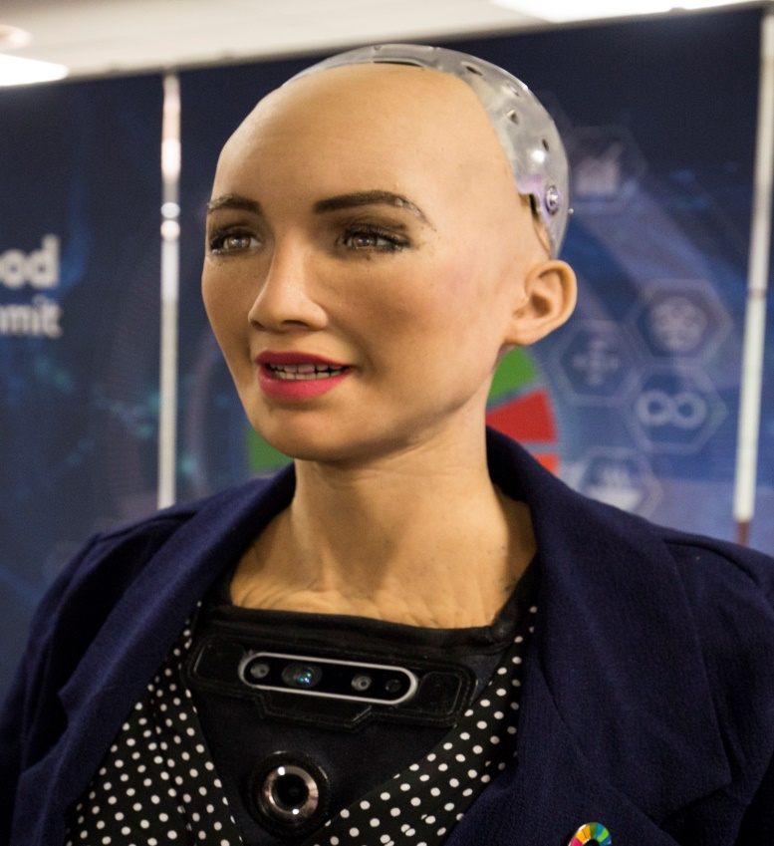
ETHICS IN ML (Contd..)
The main difference between humans making moral decisions and machines making moral decisions is that machines do not have “phenomenology” or “feelings” in the same way as humans do (Moor 2006).
They do not have “moral intuition” or “acculturation” either. Machines can process data that represents feelings (Sloman and Croucher 1981), however, no one, as yet, supposes that computers can actually feel and be conscious like people.
Lifelike robots have been developed (e.g. Hanson Robotics Sophia) but these robots do not possess phenomenal consciousness or actual feelings of pleasure or pain.

Slide 17
ETHICS IN ML -examples
The process for an ethical AI embedded in a robot starts with sensor input. We assume sensor input can be converted into symbols and that these symbols are input into a moral cognition portion of the robot’s control system.
The moral cognition system must determine how the robot should act. We use the term symbol grounding to refer to the conversion of raw sensor data to symbols. Symbols are used to represent objects and events, properties of objects and events, and relations between objects and events.

Slide 18
ETHICS IN ML -examples
Reasoning in an AI typically involves the use of logic. Logic is truth-preserving inference.
The most famous example of logical deduction comes from Aristotle. From two premises, “Socrates is a man” and “all men are mortal” the conclusion “Socrates is mortal” can be proved.
With the right logical rules, the premises we may need to deduce action will be based on symbols sensed in the environment by the robot.

Slide 19
ETHICS IN ML -examples
we can assume that our robot is tasked with issuing tickets to speeding cars. We can also assume that the minimal input the system needs to issue a ticket is the symbol representing the vehicle (e.g. the license plate number) and a symbol representing whether or not the vehicle was speeding (Speeding or NOT Speeding).
A logical rule of inference can be stated as “If driver X is speeding then the robot U is obligated to issue a ticket to driver X.”
In much the same was as we can deduce “Socrates is a mortal” from two premises, we can derive a conclusion such as “the robot U is obligated to issue ticket” from the rule of inference above and a statement like “the driver of car X is speeding.”

Slide 20
Ethics in Domain-Specific AI Algorithms
A bank using a machine learning algorithm to recommend mortgage applications for approval. A rejected applicant brings a lawsuit against the bank, alleging that the algorithm is discriminating racially against mortgage applicants.
The bank replies that this is impossible, since the algorithm is deliberately blinded to the race of the applicants. Indeed, that was part of the bank’s rationale for implementing the system.
Even so, statistics show that the bank’s approval rate for black applicants has been steadily dropping. Submitting ten apparently equally qualified genuine applicants (as determined by a separate panel of human judges) shows that the algorithm accepts white applicants and rejects black applicants.

Slide 21
Ethics in Domain-Specific AI Algorithms
If the machine learning algorithm is based on a complicated neural network, or a genetic algorithm produced by directed evolution, then it may prove nearly impossible to understand why, or even how, the algorithm is judging applicants based on their race.
On the other hand, a machine learner based on decision trees or Bayesian networks is much more transparent to programmer inspection (Hastie, Tibshirani, and Friedman 2001), which may enable an auditor to discover that the AI algorithm uses the address information of applicants who were born or previously resided in predominantly poverty-stricken areas.
It will become increasingly important to develop AI algorithms that are not just powerful and scalable, but also transparent to inspection—to name one of many socially important properties.

Slide 22
Ethics in Domain-Specific AI Algorithms
It will also become increasingly important that AI algorithms be robust against manipulation.
A machine vision system to scan airline luggage for bombs must be robust against human adversaries deliberately searching for exploitable flaws in the algorithm.

Slide 23
Ethics in Domain-Specific AI Algorithms
Another important social criterion for dealing with organizations is being able to find the person responsible for getting something done.
When an AI system fails at its assigned task, who takes the blame? The programmers? The end-users?
Modern bureaucrats often take refuge in established procedures that distribute responsibility so widely that no one person can be identified to blame for the catastrophes that result (Howard 1994).
The provably disinterested judgment of an expert system could turn out to be an even better refuge. Even if an AI system is designed with a user override, one must consider the career incentive of a bureaucrat who will be personally blamed if the override goes wrong, and who would much prefer to blame the AI for any difficult decision with a negative outcome.

Slide 24
ARTIFICIAL GENERAL INTELLIGENCE
AGI is a kind of artificial intelligence we see in the movies, like the robots from Westworld or star trek: The Next Generation. AGI is a machine with general intelligence much like a human being, to solve any problem.
Artificial general intelligence is also called strong AI or deep AI. This is a concept of the machine with general intelligence that mimics human intelligence, with the ability to think, understand, learn and apply its intelligence to solve any problem as humans do in any given situation.
Strong AI uses the theory of mind AI framework not to replicate or simulate, it’s about training machines to understand humans to differentiate needs, emotions, beliefs, and thought processes.

Slide 26
Requirements of artificial general intelligence
There are several characteristics that AGI systems should have as you see in all humans.
Common Sense
Background Knowledge
Transfer Learning
Abstraction
Causality

Slide 27
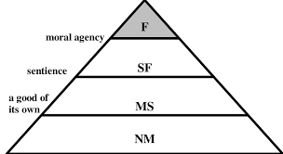
MACHINES WITH MORAL STATUS
Scheessele (2018) offers a pyramid to understand the hierarchical degrees of moral status:
The pyramid is divided into four regions:
(1) F for full moral status;
(2) SF for significant-full moral status;
(3) MS for minimal-significant moral status;
(4) NM for negligible-minimal moral status.

Slide 28
MACHINES WITH MORAL STATUS(Contd..)
An entity that meets a particular threshold will also meet all of the lower thresholds.
Philosophers mainly disagree over whether AGI would be in the “F” full moral status region or “SF” significant-full moral status region.
An AGI with full moral status would be both a moral agent and a moral patient, meaning it is subject to moral obligations and other moral expectations in addition to having its interests considered for its own sake.
Put simply, an AGI with full moral status would be held morally and individually responsible for its acts.

Slide 29
MINDS WITH EXOTIC PROPERTIES
Read:
Whether it's news articles, weblinks, books, emails, legal documents, audio and image files, and more, automatic text summarization by artificial intelligence and machine learning reads communication and reports back the essential information.
Currently, SummarizeBot can be used in Facebook Messenger or Slack and relies on natural language processing, machine learning, artificial intelligence, and blockchain technologies.
https://quillbot.com/summarize

Slide 30
MINDS WITH EXOTIC PROPERTIES
Write:
AI is able to expand beyond this to more creative writing as well.
Many marketers are turning to artificial intelligence to craft their social media posts. Even a novel has even been generated by artificial intelligence that was short-listed for an award. “The Day A Computer Writes A Novel”
https://medium.com/the-research-nest/interesting-novels-written-by-artificial-intelligence-d407e330fe07

Slide 31
MINDS WITH EXOTIC PROPERTIES
See:
Machine vision is when computers can “see” the world, analyze visual data, and make decisions about it.
There are so many amazing ways machine vision is used today, including enabling self-driving cars, facial recognition for police work, payment portals, and more.
In manufacturing, the ability for machines to see helps in predictive maintenance and product quality control.

Slide 32
MINDS WITH EXOTIC PROPERTIES
Hear and understand:
Did you know artificial intelligence is able to detect gunshots, analyze the sound, and then alert relevant agencies? This is one of the mind-blowing things AI can do when it hears and understands sounds.
Business professionals love the convenience, efficiency, and accuracy provided by AI through automated meeting minutes.

Slide 33
MINDS WITH EXOTIC PROPERTIES
Speak:
Artificial intelligence can also speak. While it’s helpful (and fun) to have Alexa and Google Maps respond to your queries and give you directions, Google Duplex takes it one step further and uses AI to schedule appointments and complete tasks over the phone in very conversational language.
It can respond accurately to the responses given by the humans it’s talking to as well.

Slide 34
MINDS WITH EXOTIC PROPERTIES
Smell:
There are artificial intelligence researchers who are currently developing AI models that will be able to detect illnesses—just by smelling a human's breath.
It can detect chemicals called aldehydes that are associated with human illnesses and stress, including cancer, diabetes, brain injuries, and detecting the "woody, musky odor" emitted from Parkinson's disease even before any other symptoms are identified.
Artificially intelligent bots could identify gas leaks or other caustic chemicals, as well. IBM is even using AI to develop new perfumes.

Slide 35
MINDS WITH EXOTIC PROPERTIES
Touch:
Using sensors and cameras, there's a robot that can identify "supermarket ripe" raspberries and even pick them and place them into a basket!
Its creator says that it will eventually be able to pick one raspberry every 10 seconds for 20 hours a day! The next step for AI tactile development is to link touch with other senses.
https://www.youtube.com/watch?v=AcfVlBlapks

Slide 36
MINDS WITH EXOTIC PROPERTIES
Move:
Artificial intelligence propels all kinds of movement from autonomous vehicles to drones to robots.
The Alter 3 production at Tokyo’s New National Theatre features robots that can generate motion autonomously.
https://www.youtube.com/watch?v=neM 5hUftbmg

Slide 37
MINDS WITH EXOTIC PROPERTIES
Understand emotions:
Market research is being aided by AI tools that track a person’s emotions as they watch videos.
Artificial emotional intelligence can gather data from a person's facial expressions, body language, and more, analyze it against an emotion database to determine what emotion is likely being expressed, and then determine an action based on that info.

Slide 38
MINDS WITH EXOTIC PROPERTIES
Play games:
It's not all serious business with artificial intelligence—it can learn to play games such as chess, Go, and poker (which was an incredible feat)! And, turns out that AI can learn to play these games plus compete and even beat humans at them!

Slide 39
MINDS WITH EXOTIC PROPERTIES
Create:
Artificial intelligence can even master creative processes, including making visual art, writing poetry, composing music, and taking photographs.
Google's AI was even able to create its own AI “child”—that outperformed human-made counterparts.

Slide 40
MINDS WITH EXOTIC PROPERTIES
Read your mind:
AI that can read your mind! It can interpret brain signals and then create speech.
Impressive and life-changing for those with speech impairment, but a little bit unnerving when you consider the mind-reading aspect of the skill.
It's no surprise that some of the biggest tech giants, including Facebook and Elon Musk have their own projects underway to capitalize on AI's mind-reading potential.

Slide 41
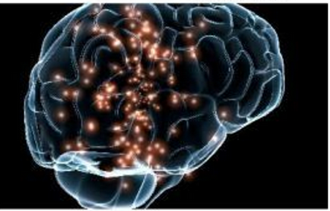
SuperIntelligence

Slide 42
Superintelligence
A superintelligence is an agent that possesses intelligence far surpassing that of the brightest and most gifted human minds.
Superintelligence" may also refer to a property of problem-solving systems (e.g., superintelligent language translators or engineering assistants) whether or not these high-level intellectual competencies are embodied in agents that act in the world.
Nick Bostrom defines superintelligence as "any intellect that greatly exceeds the performance of humans in virtually all domains of interest".

Slide 43
Feasibility of artificial superintelligence
AI can achieve equivalence to human intelligence, that it can be extended to surpass human intelligence, and that it can be further amplified to completely dominate humans across arbitrary tasks-David Charmers
If research into strong AI produced sufficiently intelligent software, it would be able to reprogram and improve itself – a feature called "recursive self-improvement". It would then be even better at improving itself, and could continue doing so in a rapidly increasing cycle, leading to a superintelligence. This scenario is known as an intelligence explosion.

Slide 44
Potential threats to humanity
Superintelligence may be able to seize power over its environment and prevent humans from shutting it down. Since a superintelligent AI will likely have the ability to not fear death and instead consider it an avoidable situation which can be predicted and avoided by simply disabling the power button.
Potential AI control strategies include
→ "capability control" (limiting an AI's ability to influence the world)
"motivational control" (building an AI whose goals are aligned with human values).

Slide 45
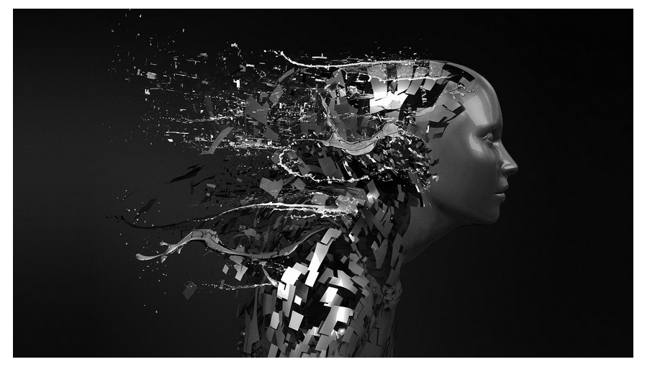
Benefits and Risks of Artificial Intelligence

Slide 46
Benefits of AI
1. Increase work efficiency
AI-powered machines are great at doing a particular repetitive task with amazing efficiency. The simple reason is that they remove human errors from their tasks to achieve accurate results every time they do that specific task.
Moreover, such machines can work 24X7, unlike humans. Thus, they eliminate the need to deploy two sets of employees working day and night shifts to work on important tasks. For example, AI-powered chat assistants can answer customer queries and provide support to visitors every minute of the day and boost the sales of a company.

Slide 47
Benefits of AI
2. Work with high accuracy
Scientists are working to teach artificial intelligence powered machines to solve complex equations and perform critical tasks on their own so that the results obtained have higher accuracy as compared to their human counterparts.
Their high accuracy has made these machines indispensable to work in the medical field particularly, owing to the criticality of the tasks. Robots are getting better at diagnosing serious conditions in the human body and performing delicate surgeries to minimize the risk of human lives.

Slide 48
Benefits of AI
3. Reduce the cost of training and operation
AI uses machine learning algorithms like Deep Learning and neural networks to learn new things like humans do. This way they eliminate the need to write new code every time we need them to learn new things.

Slide 49
Other benefits
AI has an impact on
1. Economics
2. Law
3. Technical Areas
4. Validity, security, and control
5. It controls your car, your airplane, your pacemaker, your automated trading system, or your power grid

Slide 50
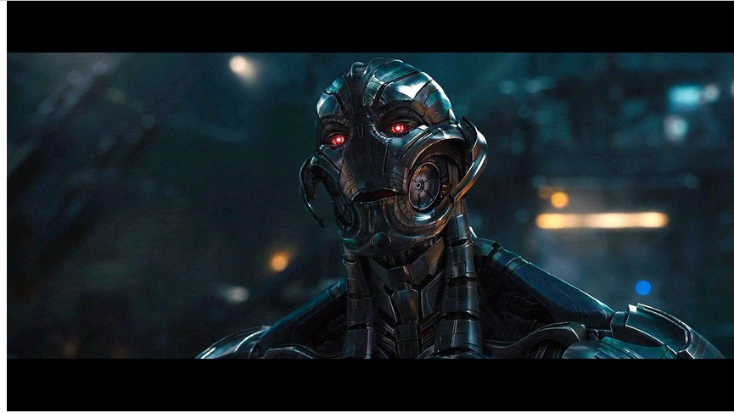
Risks of AI

Slide 51
Risks of Artificial Intelligence
How can AI be dangerous?
The AI is programmed to do something devastating:
It may be like weapons in the hands of the wrong person- leads to mass casualties and AI war.
Autonomous weapons are artificial intelligence systems that are programmed to kill.
To avoid being thwarted by the enemy, these weapons would be designed to be extremely difficult to simply “turn off,” so humans could plausibly lose control of such a situation.
This risk is one that’s present even with narrow AI, but grows as levels of AI intelligence and autonomy increase.

Slide 52
Risks of Artificial Intelligence
How can AI be dangerous?
2. The AI is programmed to do something beneficial, but it develops a destructive method for achieving its goal:
AI goal is not aligned with the human goal:
Eg : AI Cars literally follow our instructions and lack in understanding human emotions.

Slide 53
Types of Artificial Intelligence
Types of AI
1. Narrow AI(Weak AI)
It is designed to perform a narrow task.
It outperforms humans at whatever its specific task is, like playing chess or solving equations
Eg: Face Recognition, Internet search
2. General AI(Strong AI)
AGI would outperform the humans.

Slide 54
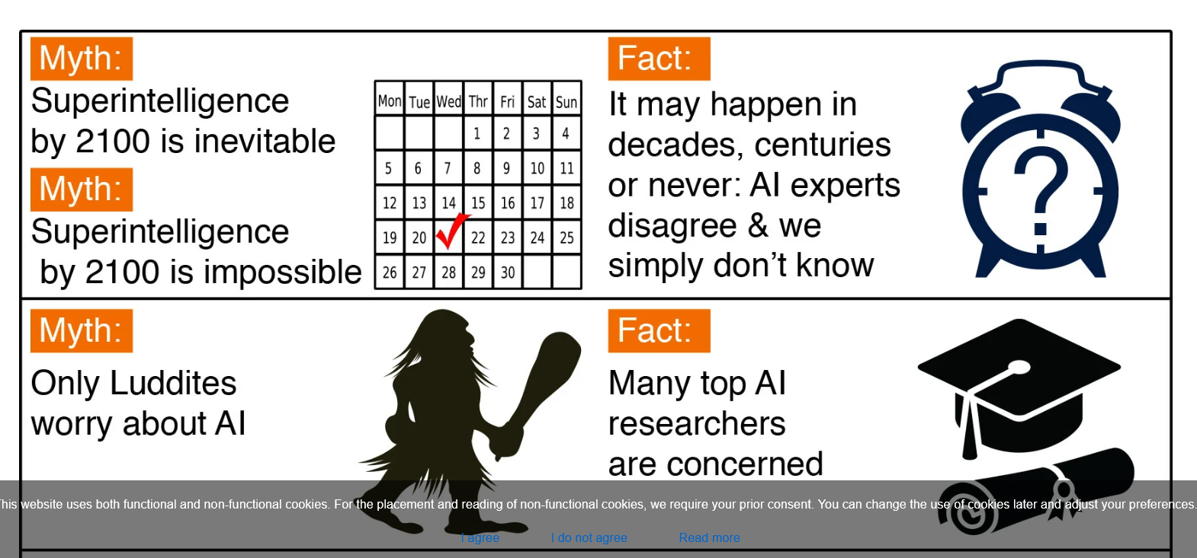
Top Myths About Advanced AI

Slide 55
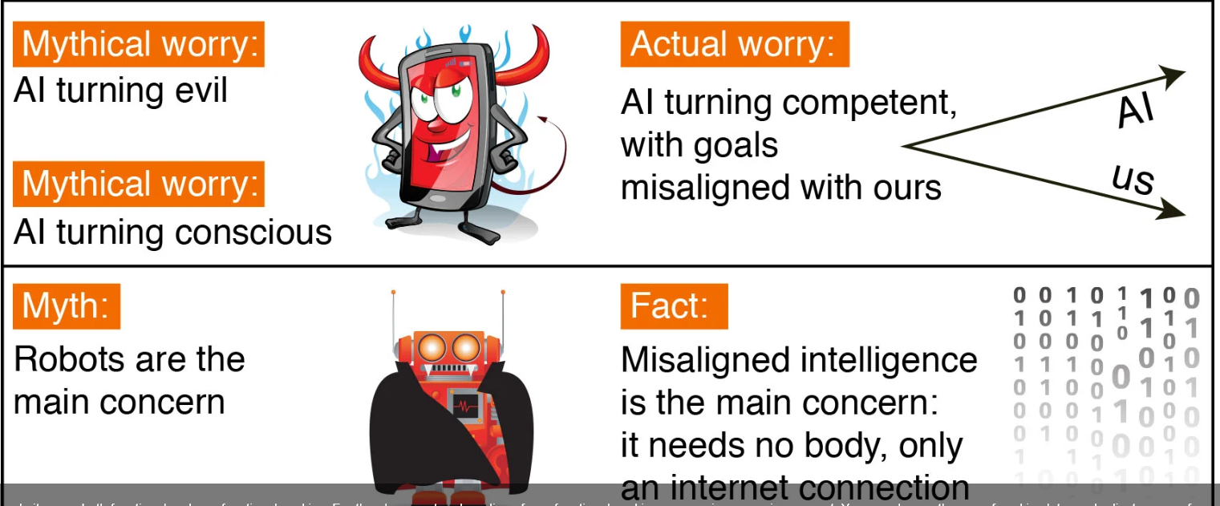
Top Myths About Advanced AI

Slide 56
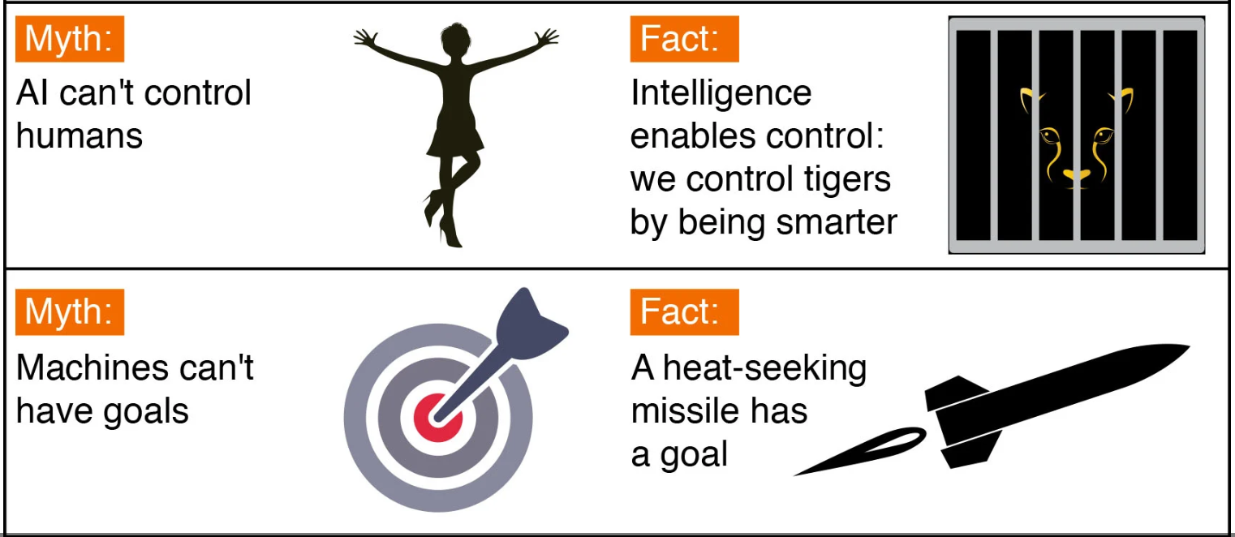
Top Myths About Advanced AI

Slide 57
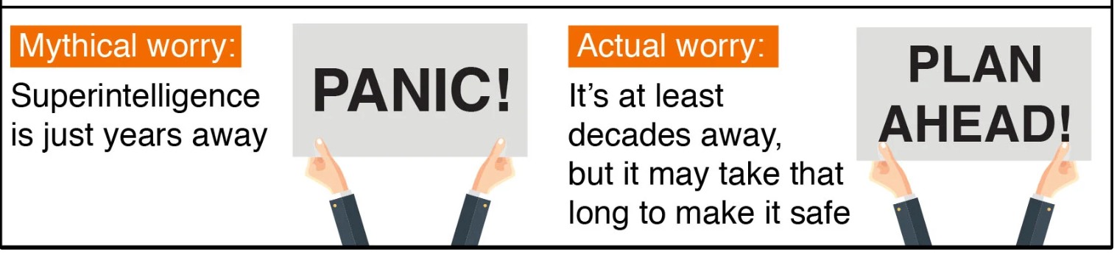
Top Myths About Advanced AI

